Slide 1
Blindsided by Kratom
The Accessible Opioid
Dr Honor Ashbaugh, MD

Slide 2
Is Kratom a Drug?
A drug is a medication or other substance (including a natural substance) that has a physiologic effect when either ingested or otherwise introduced into the body.

Slide 3
Kratom (Mitragyna Speciosa)
What is it?
Tropical tree native to Southeast Asia
  Cambodia, Thailand, Indonesia, Malaysia, Philippines, Papua New Guinea
Kratom leaves used as an herbal remedy for centuries
  Chewing leaves and smoking
Socioreligious Ceremonies
Treatment of various medical conditions
  To combat fatigue and improve work productivity [1]
  For cognitive Enhancement
  Opioid dependence [2]
  Opiate substitute [2]- Pain control

Slide 4
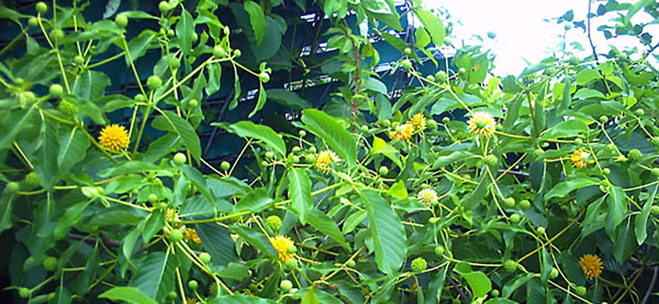

Slide 5
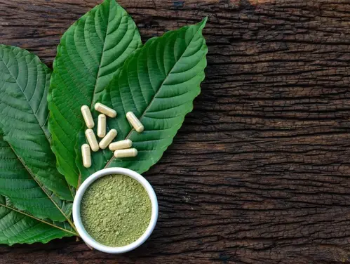

Slide 6
History
Evolution of humanity has many examples of natural substances used for cognitive enhancement (Nootropics)
Kratom introduced to the US in the late 1990’s, early 2000’s
Widespread use by 2015
Significant increase in use surrounding opioid epidemic
  Self-medication of opiate withdrawal symptoms
Increased availability in the age of the internet
  Misleading marketing strategies
  Increased risks and a brand-new set of problems

Slide 7
What is Kratom Used For
Perceived therapeutic effects or recreational use
Used for stimulant and opioid-like properties
  Increase alertness, physical energy, talkativeness
  Pain relief
  Depression
  Anxiety
  Opioid withdrawal symptoms
  Sleep
  Cough
  Diarrhea
Effects are seen within 10-30 minutes
Effects peak at 1-2 hours and last 4-6 hours

Slide 8
Kratom as Treatment for Opioid Withdrawal
Kratom frequently used to treat opioid withdrawal symptoms
Perceived as cheaper and more “natural” than methadone or buprenorphine
No reliable evidence that Kratom is an effective alternative [14,15]
Increases risk of habitual Kratom use/dependence
Underlying addiction inadequately addressed

Slide 9
How is Kratom Used?
Smoking
Powder
Capsule or pill
Beverages
Edible product
Extracts and Tinctures
Rarely reports of intravenous use

Slide 10
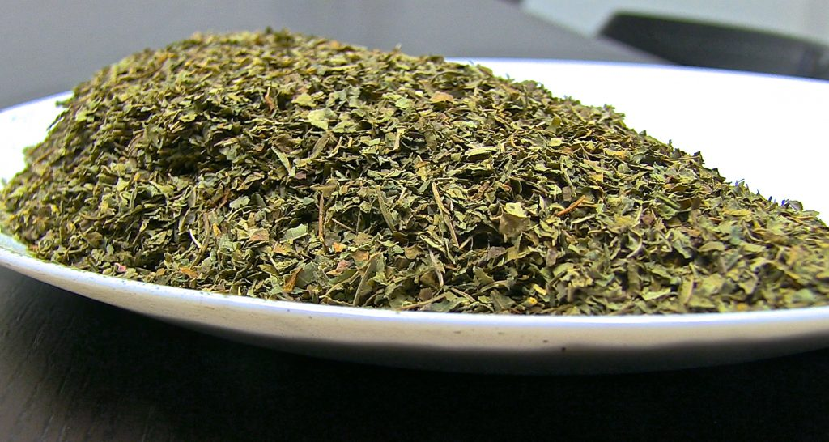

Slide 11


Slide 12
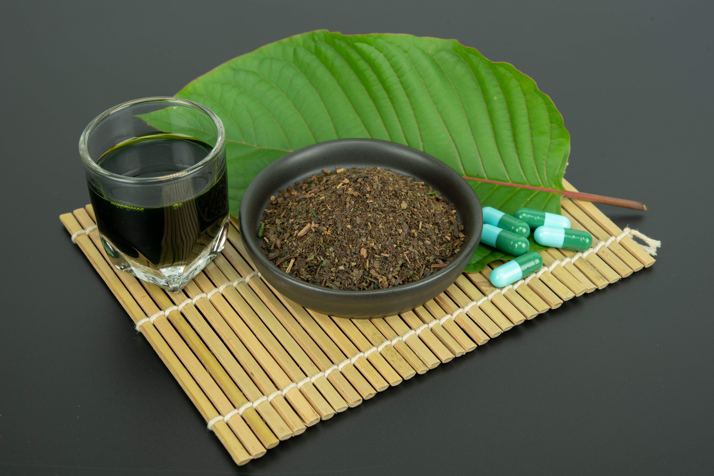

Slide 13
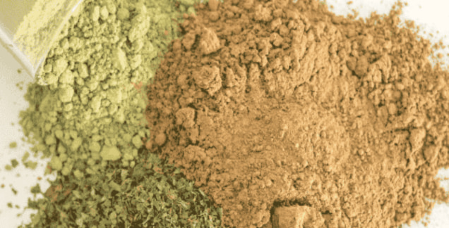

Slide 14
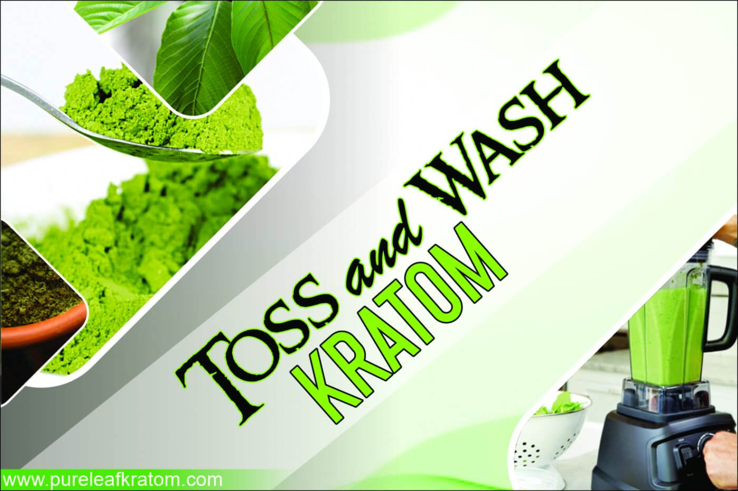

Slide 15
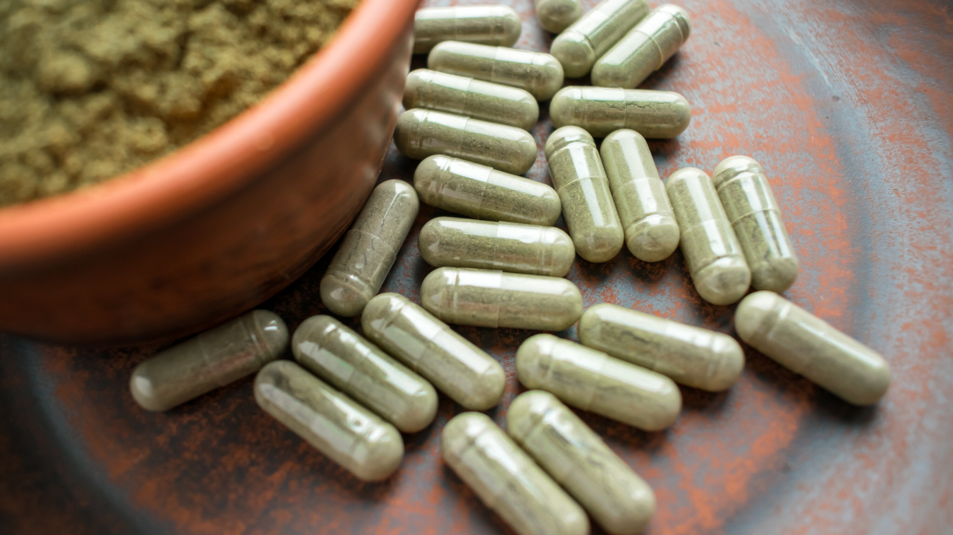

Slide 16
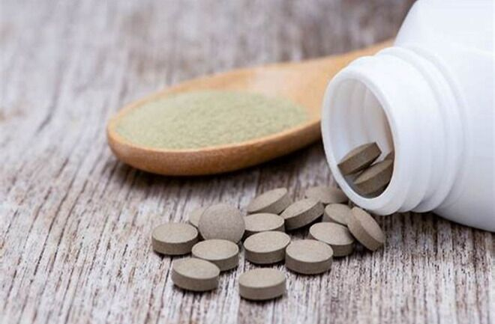

Slide 17
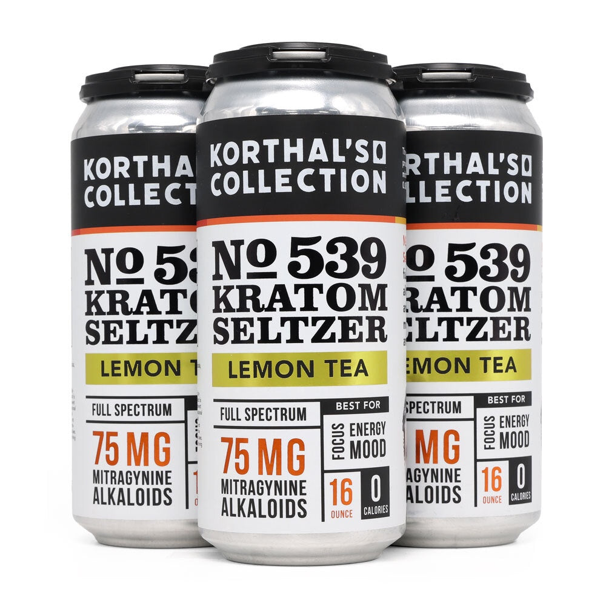

Slide 18
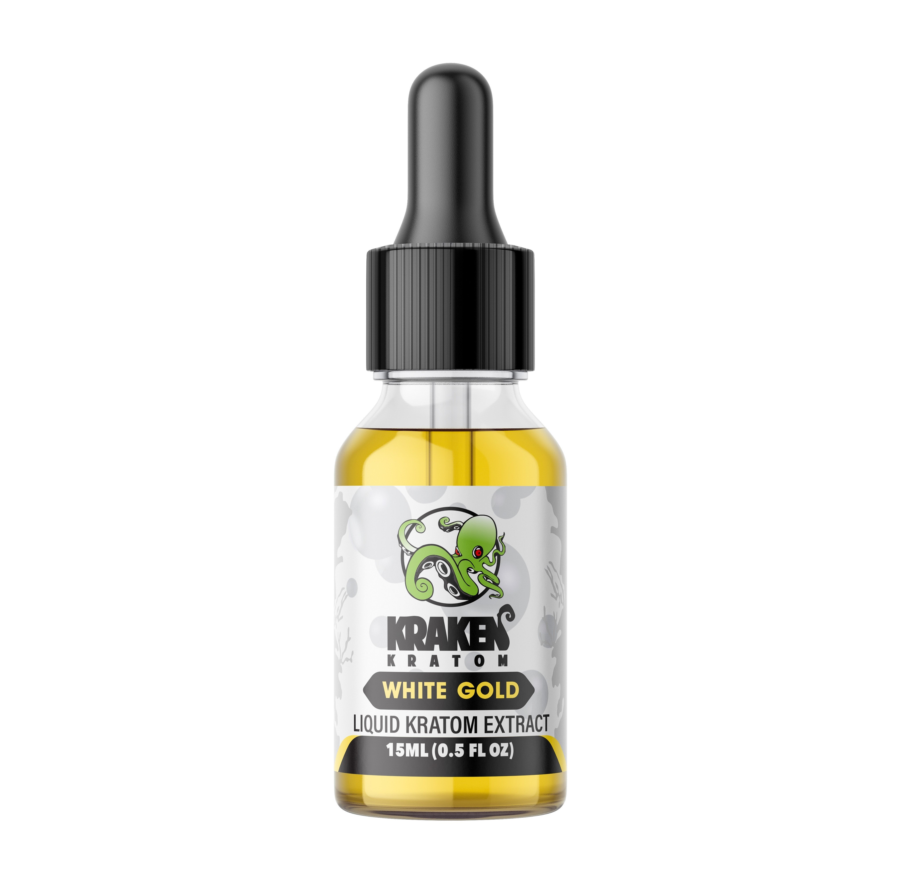

Slide 19
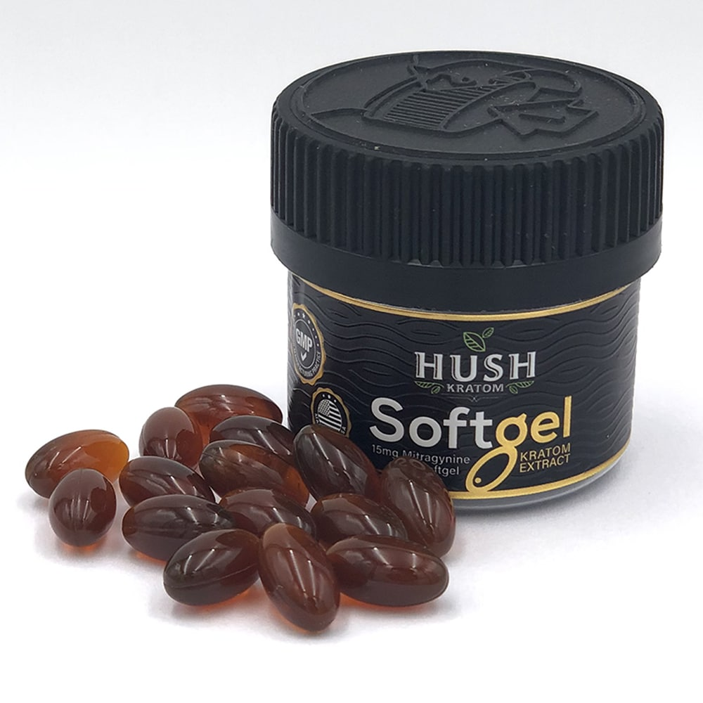

Slide 20
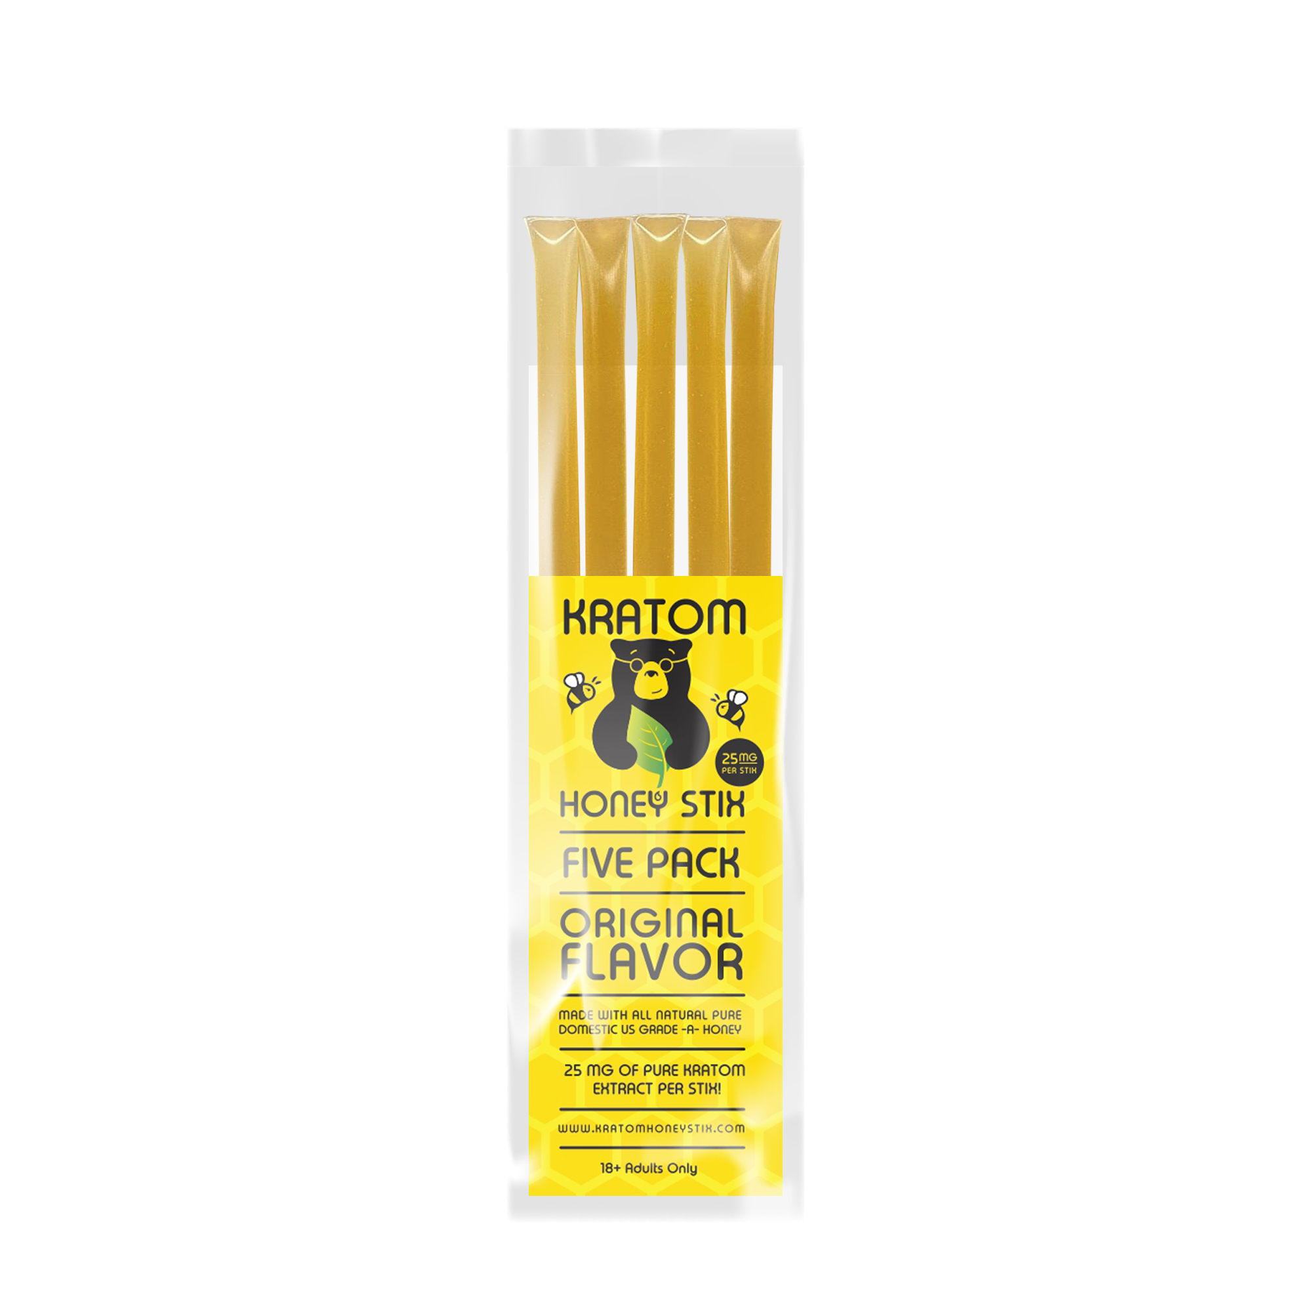

Slide 21
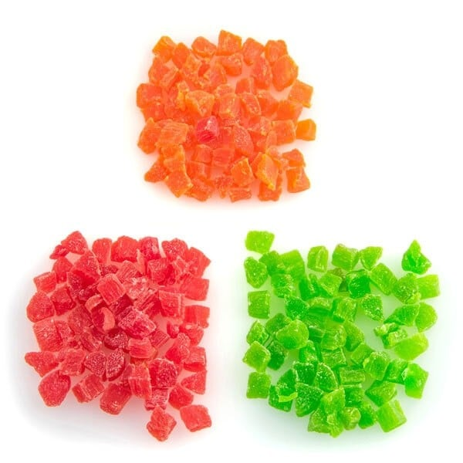

Slide 22
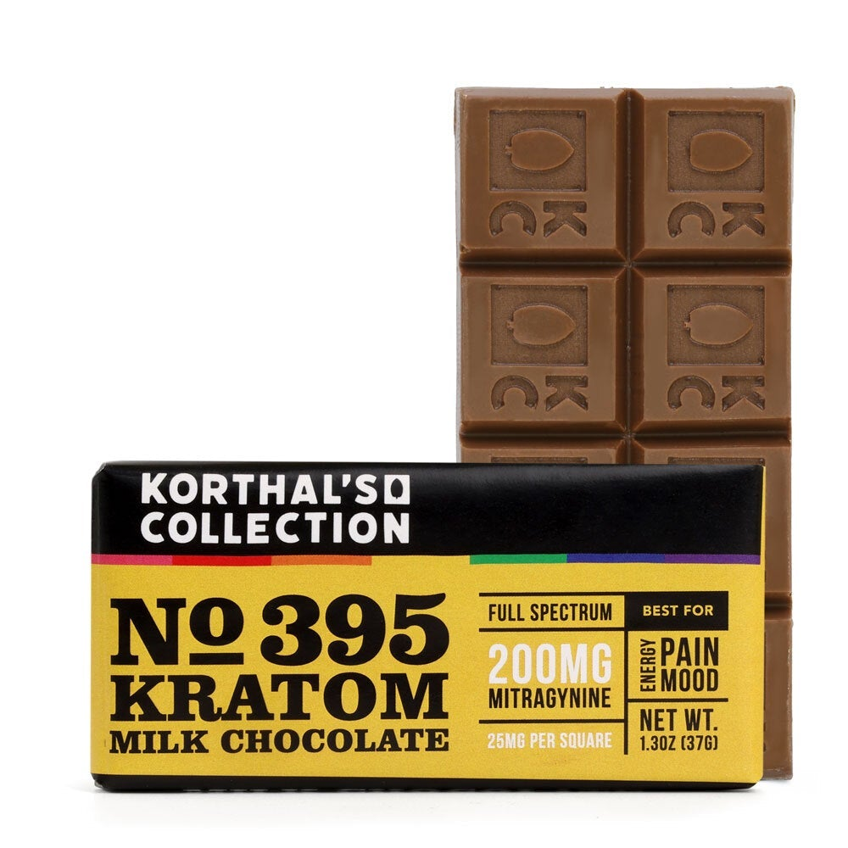

Slide 23
Where is Kratom Purchased
Online vendors
Smoke shops
Gas-stations- Gas-station heroin
Convenience stores

Slide 24
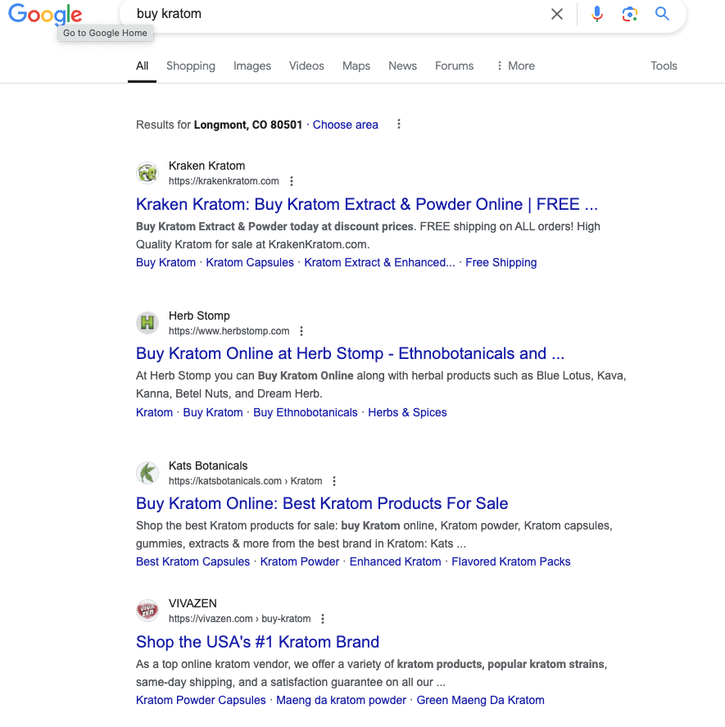

Slide 25
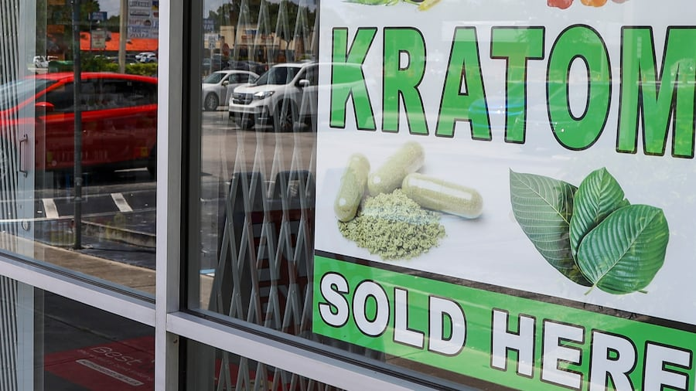

Slide 26
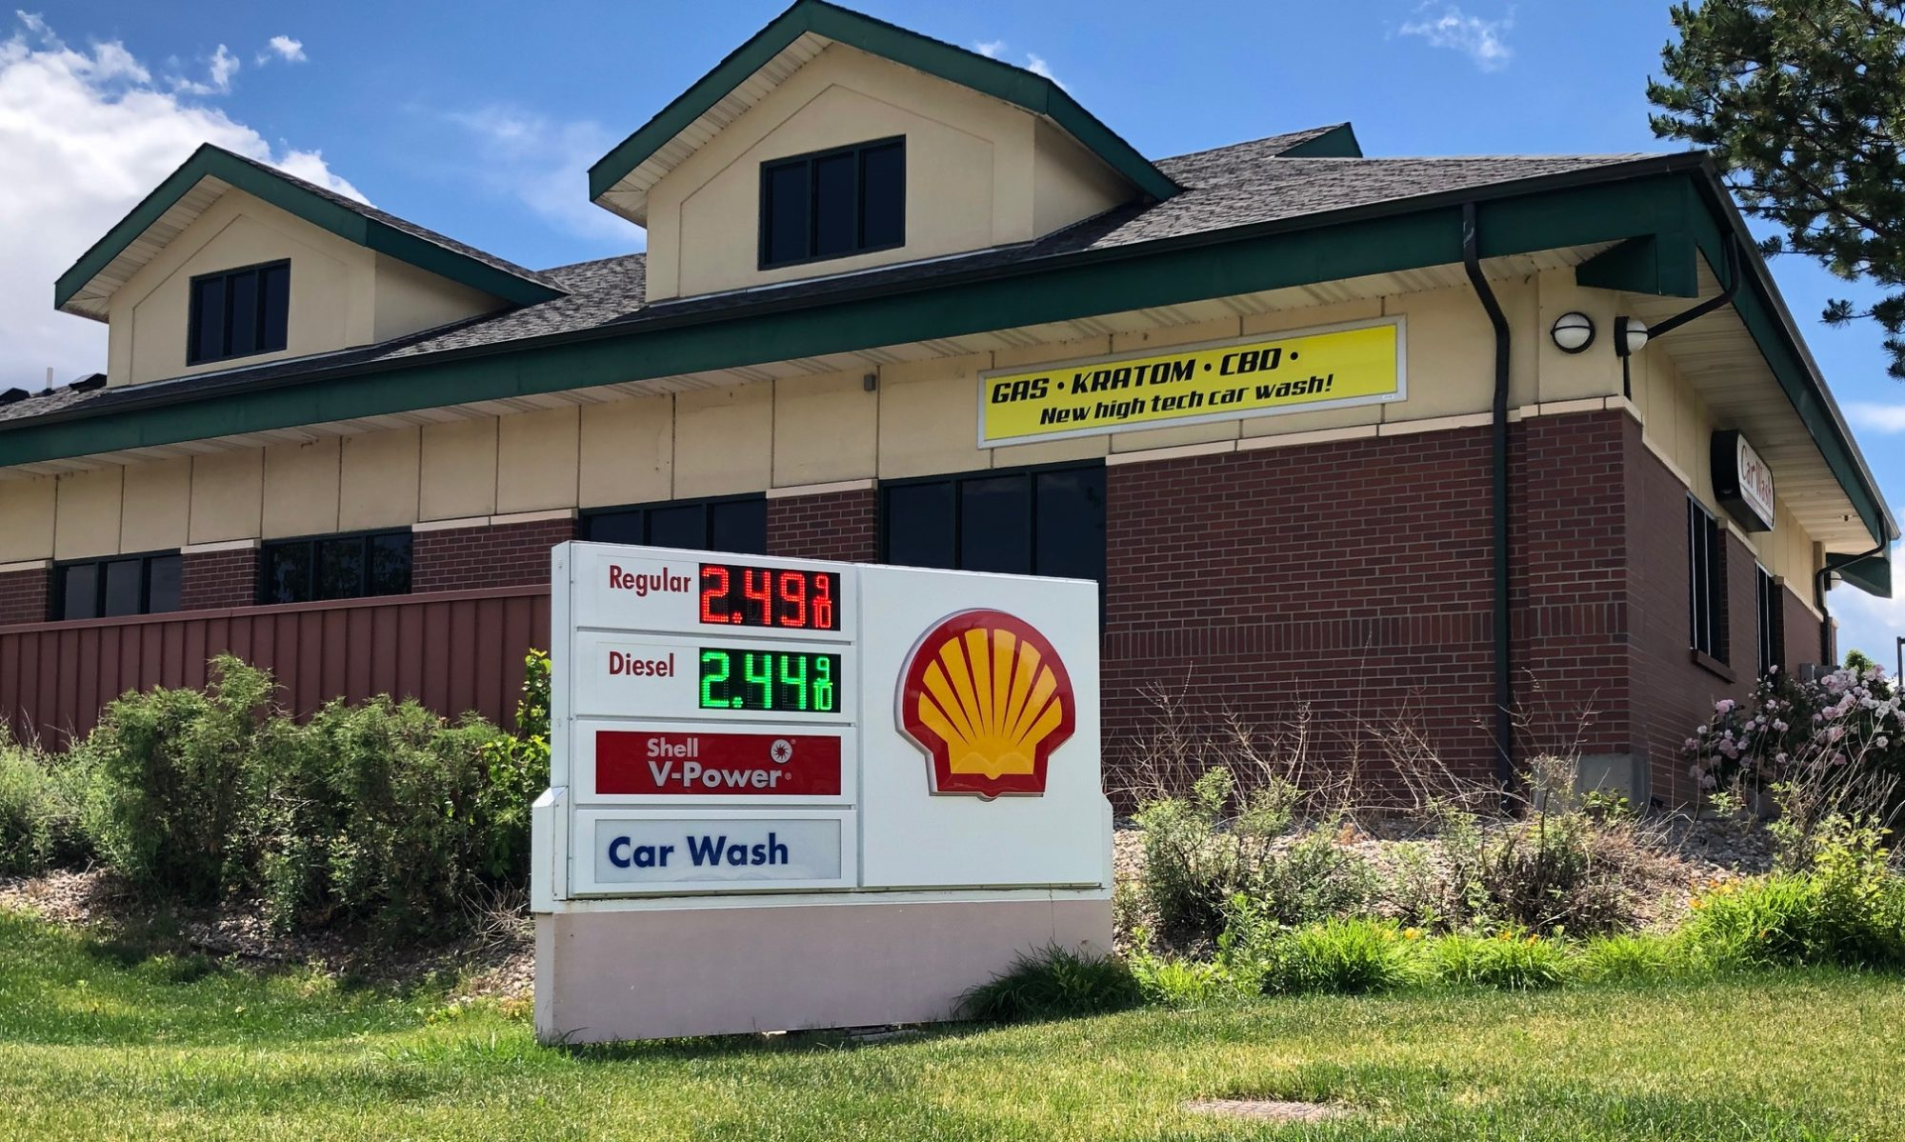

Slide 27
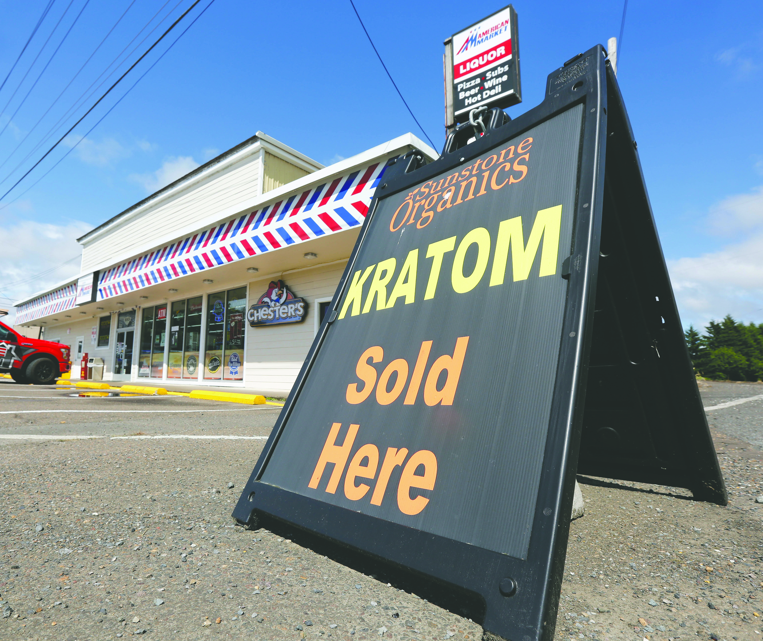

Slide 28
Kratom: A Naturally Occurring Opioid
Psychoactive substance acting as a naturally occurring opioid
In 2021 an estimated 3-5 million Americans used kratom
Legal in most US states and in many other countries
Illegal to buy, sell, possess or use in the following states
  Alabama, Arkansas, Indiana, Louisiana, Wisconsin, Vermont, and Connecticut
  Pending bills to reverse this
Restrictions exist in many states where Kratom is legal

Slide 29
Regulation of Kratom in the US
DEA attempted to classify Kratom as a Schedule I drug in 2016
  Reversal due to thousands of petitioners, public protests, and appeals from congress. Sited were medical benefits.
  Kratom is not a controlled substance, but of concern
FDA- Kratom is a new dietary supplement with lack of favorable scientific data to assure lack of illness or injury
  Illegal to market as dietary supplement
No prescription or OTC drugs containing Kratom approved by FDA
  FDA warms against use of Kratom to treat medical conditions
Unsafe food additive making it illegal to market as such
Little to no oversight results in inconsistency of product and strength

Slide 30
Regulation of Kratom in Colorado
Colorado Kratom Consumer Protection Act SB 25-072
  Effective May 29, 2025 (Daniel Bregger Act)
Registration of Kratom products with the Department of Revenue
  Submission of certificate of analysis from a third-party lab
  Department of revenue (DOR) maintains and publishes a list of processors and collects sales data
  DOR may require a compliance test from a 3rd party lab
  Processors must notify DOR of adverse events related to their products
Enforcement consists of fines on processors that violate the bill

Slide 31
Regulation of Kratom in Colorado
Communities in Colorado may regulate kratom sales
  Denver legal to sell but banned for human consumption
  Cannot buy in Parker or Monument.
General Prohibitions
  Adulterating a Kratom product with fentanyl or other controlled substance
  Selling a Kratom product without a label listing all ingredients
  Selling a Kratom product to a person under 21 years of age
  Displaying or storing a Kratom product in retail location that can be accessed by individuals under 21 years of age

Slide 32
Regulation of Kratom in Colorado
General Prohibitions ctd
  Selling kratom products that are combustible or intended for vaporization
  Selling Kratom product with greater that 2% of total alkaloid product being 7-hydroxymitragynine
  Sell a Kratom product containing synthetic components
  Represent that the Kratom product is a food product
  Represent that the Kratom product treats specific medical conditions
  Sell a Kratom product without registering with the state
  Must report adverse events

Slide 33
Opiate and Opioid Basics
Class of drugs known as narcotics
  Latin narcoticus- Sleep inducing or numbness inducing
Opiates- naturally occurring and derived from seed pods of the opium poppy flower
Four naturally occurring opiates
  Morphine- archetypal opioid
  Codeine
  Papaverine
  Thebaine
Opioids- Not naturally occurring
  Semi-synthetic- Partially derived from components of opium
  Synthetic- Fully man-made

Slide 34


Slide 35
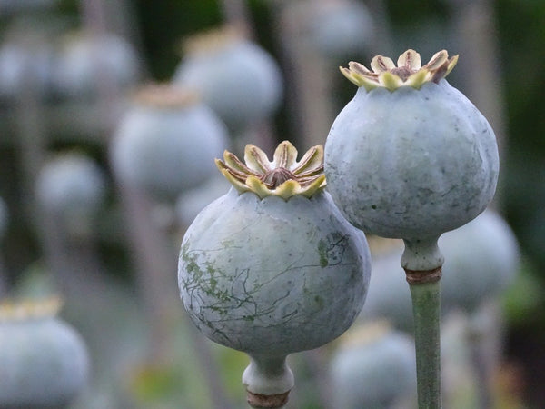

Slide 36
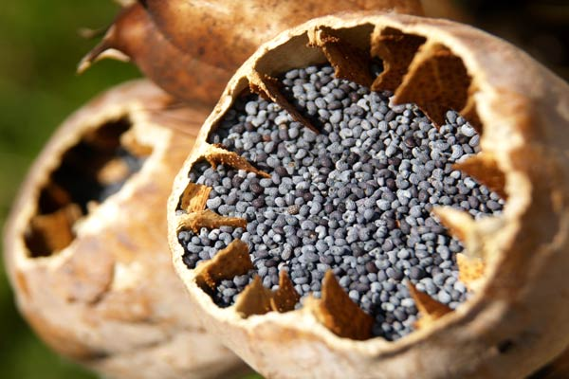

Slide 37
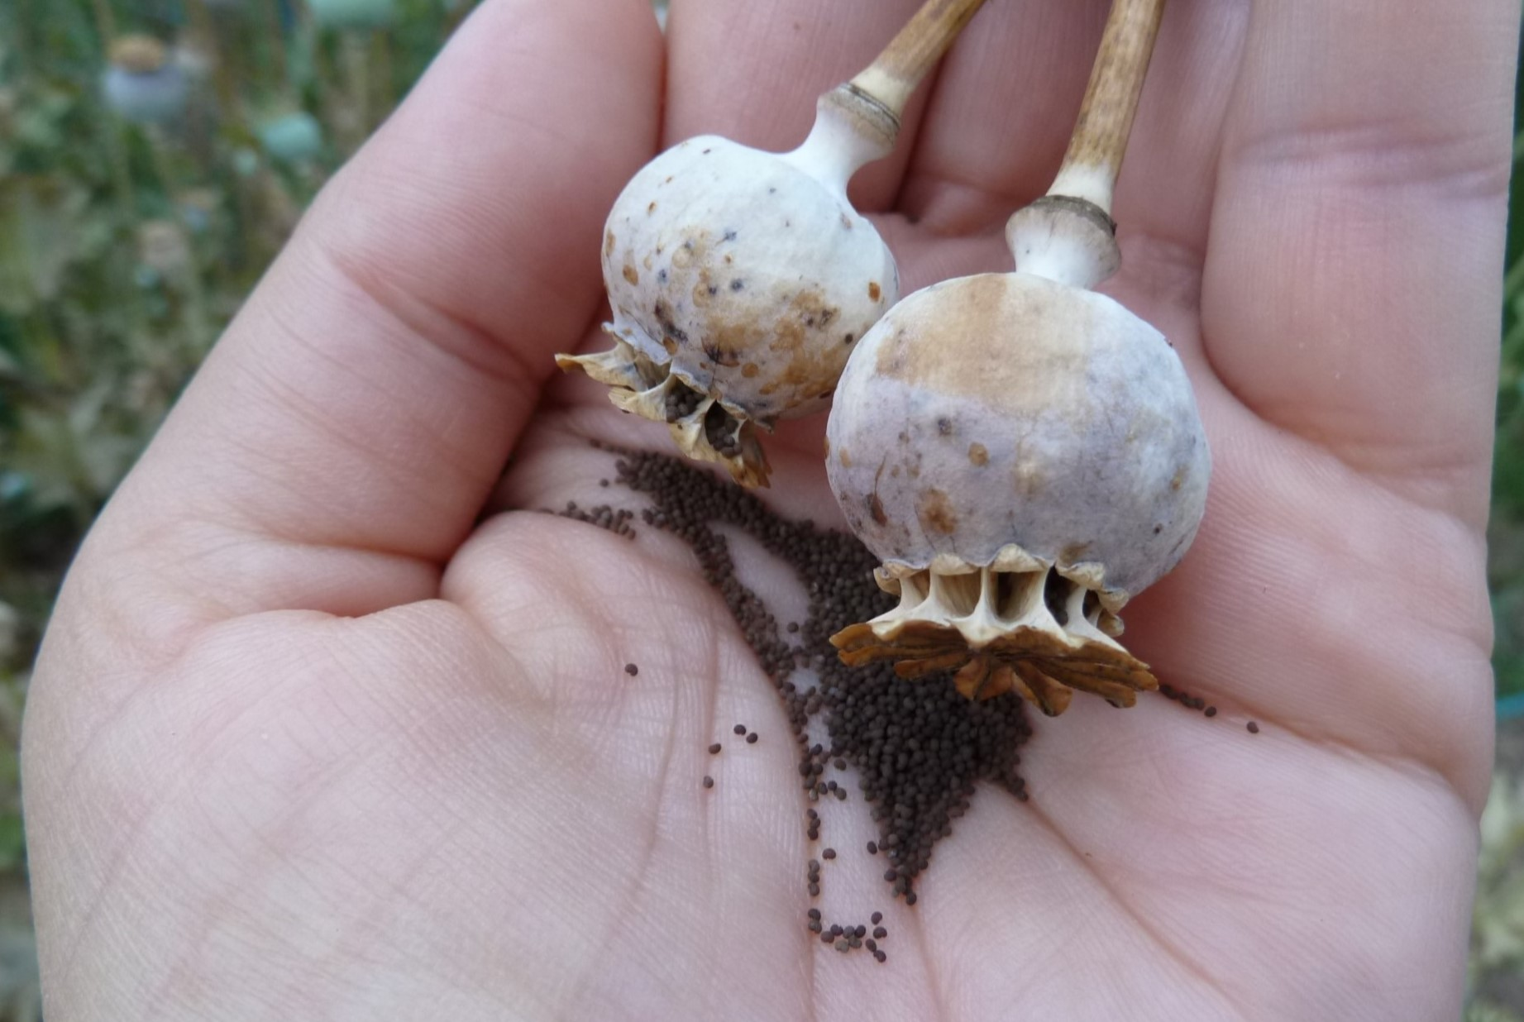

Slide 38
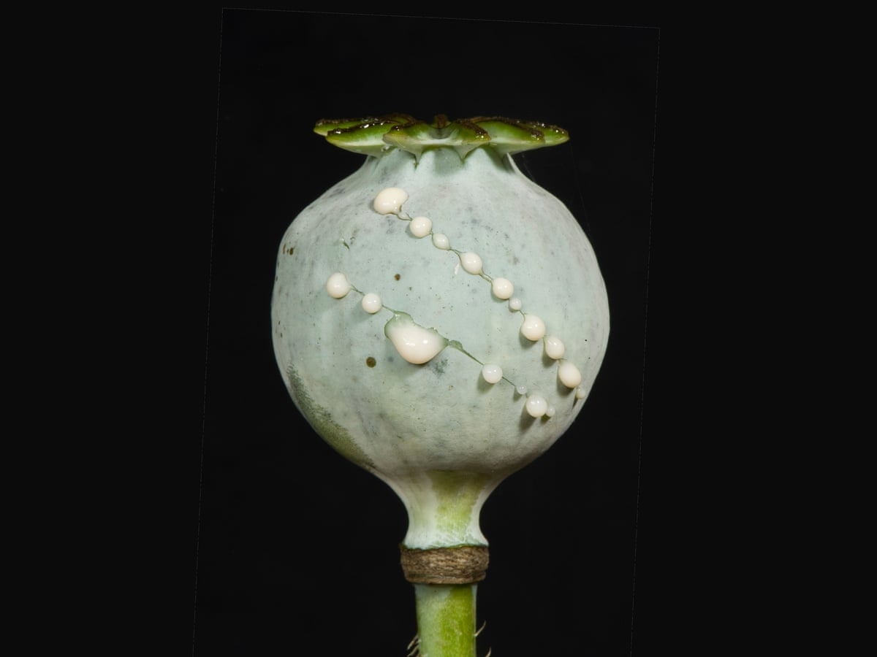

Slide 39
Semi-synthetic and Synthetic Opioids
Semi-synthetic opioids
  Hydrocodone- Vicodin, Lortab, Norco
  Hydromorphone- Dilaudid
  Oxycodone- Oxycontin, Percocet
  Buprenorphine- Suboxone
  Heroin
Synthetic opioids
  Fentanyl
  Tramadol- Ultram
  Meperidine- Demerol
  Methadone

Slide 40
Effects of Opiates and Opioids
Analgesia- Pain Control
Cough Suppression
Relaxation
Drowsiness
Euphoria
Confusion
Nausea
Constipation
Pruritis
Tolerance and dependence
Respiratory depression

Slide 41
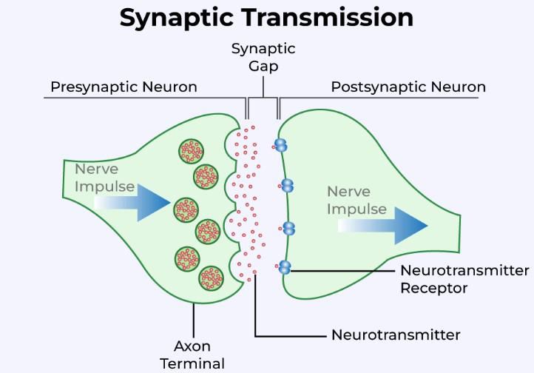

Slide 42
Drugs as Agonists and Antagonists
Agonist- Binds to receptor to initiate a maximal response
  Morphine
Partial Agonist- Initiates a partial response Independent of dose
  Buprenorphine
Antagonist- Binds to receptor without producing a response
  Naloxone
  Naltrexone

Slide 43
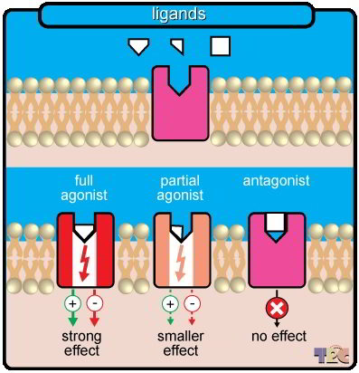

Slide 44
Opioid Pharmacology
Three main types of opioid receptors
  Delta- DOP
  Kappa- KOP
  Mu– MOP
    Highest expression
Location of opioid receptors
  Central Nervous System
  Spinal Cord
  Gastrointestinal System
  Peripheral Nervous System

Slide 45
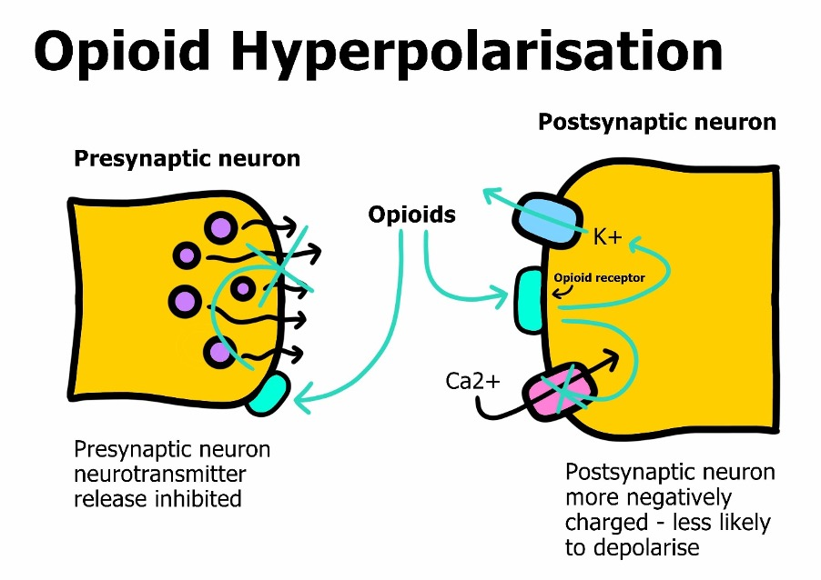

Slide 46
Opioid Pharmacology
Opioid receptors are found presynaptically and postsynaptically
Most MOP receptors are presynaptic and suppress the release of GABA [4]
  Allows dopamine to be released more vigorously
MOP Receptor Activation
  Analgesia, sedation, respiratory depression, decreased GI motility, nausea and vomiting and bradycardia [5,6]
DOP Receptor Activation
  Analgesia and decreased GI motility [5,6]
KOP Receptor Activation
  Analgesia, diuresis, dysphoria [5,6]

Slide 47
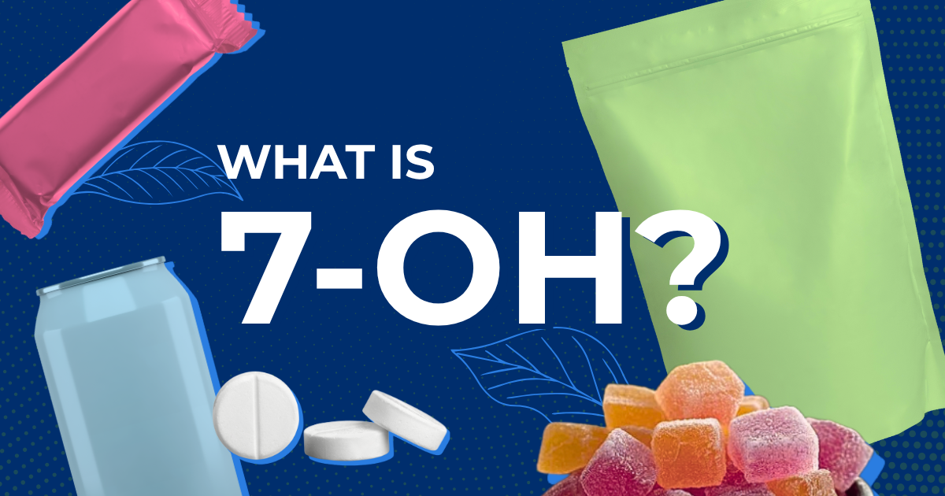

Slide 48
Kratom Pharmacology and 7-OH
Kratom does not denote a single, specific compound
  A cocktail of psychoactive alkaloids- nitrogenous molecule found in plants
  Kratom extracts reveal high diversity of alkaloid content
  More than 40 identified to date
Two main components [8]
  Mitragynine most prevalent [9]
    Up to 66% of total alkaloid content [9]
    Component identified in drug testing
  7-hydroxymitragynine (7-OH mitragynine)
    Up to 2% of total alkaloid component
    Main metabolite of mitragynine

Slide 49
Kratom Pharmacology and 7-OH
Mixture of stimulant and opiate-like properties
  Stimulant properties at low doses [10,11]
  Opiate-like properties at high doses [10]
Mitragynine and 7-OH-mitragynine target opioid receptors (MOP and KOP)
  Act as a partial agonist at the MOP
  Affinity of mitragynine is less than that of morphine [11,12]
  Affinity of 7-OH-mitragynine is 5-10 times higher than morphine [10,11]
  Potency of 7-OH is 10-20 fold more potent than morphine

Slide 50
Regulation of 7-OH in Colorado
  Problems with regulation of 7-OH
  Some products marketed as 7-OH actually do meet the 2% alkaloid limit
  The product may not be compliant
  Enforcement lags behind enactment
  Regulatory ambiguity
    Argued that certain concentrated 7-OH products may not fall inside the statute’s definition of a kratom product
    Debate surrounding how the 2% standard should be measured
    Uncertainty for manufacturers and enforcement agencies

Slide 51
Regulation of 7-OH in Colorado
  A key point is that the law does not say 7-OH cannot exceed 2% of the mitragynine concentration. It says 7-OH mitragynine cannot exceed 2% of the product’s total kratom alkaloid content.
  This wording has led to debate
  Some manufacturers attest that their product falls outside the statutory definition of a “kratom product”
  If you see high potency 7-OH on shelves today, it doesn’t necessarily mean they are compliant.
  Products may remain on the market while regulatory agencies determine compliance and pursue enforcement

Slide 52
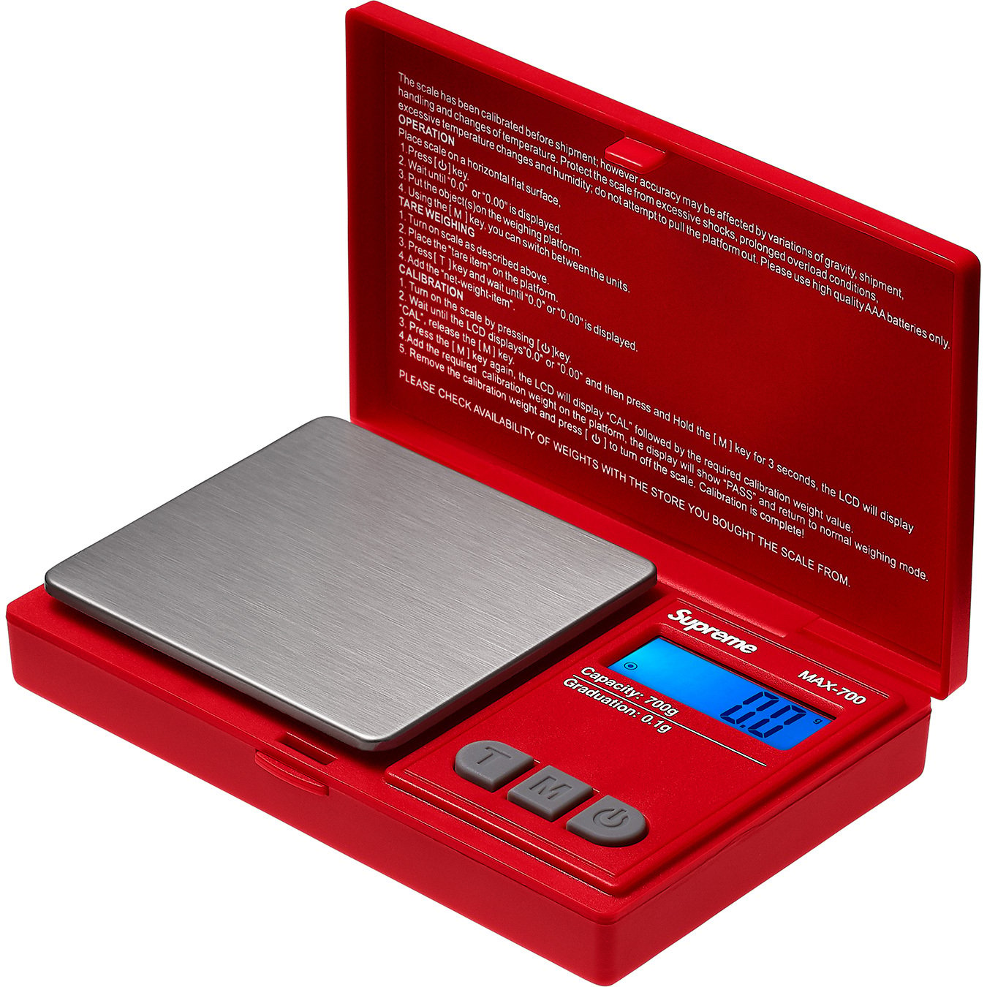

Slide 53
Measurements and Dosing
No specific unit of measurement
  Difficult to quantify amounts
  Since Kratom is unregulated, stated strength may not be accurate
  Large variation in amount of mitragynine and 7-OH mitragynine in different samples
Kratom powder and leaves typically measured in grams
  1gm Kratom contains anywhere between 12.5mg-60mg mitragynine
Kratom extract 0.5gm equivalent to 5-6gm powder

Slide 54
Measurement and Dosing
Typical dose is between 2gm and 12gm or (25mg to 720mg mitragynine)
  Microdose less than 2gm (120mg mitragynine)
  Low dose 2gm to 6gm (less than 360mg mitragynine)
  High dose over 6gm (more than 360mg mitragynine)
  Heavy dose greater than 8gm (more than 480mg mitragynine)

Slide 55
Kratom Powder
Around 6gm per Tbsp

Slide 56
Kratom Leaves
Around 6gm per Tbsp

Slide 57
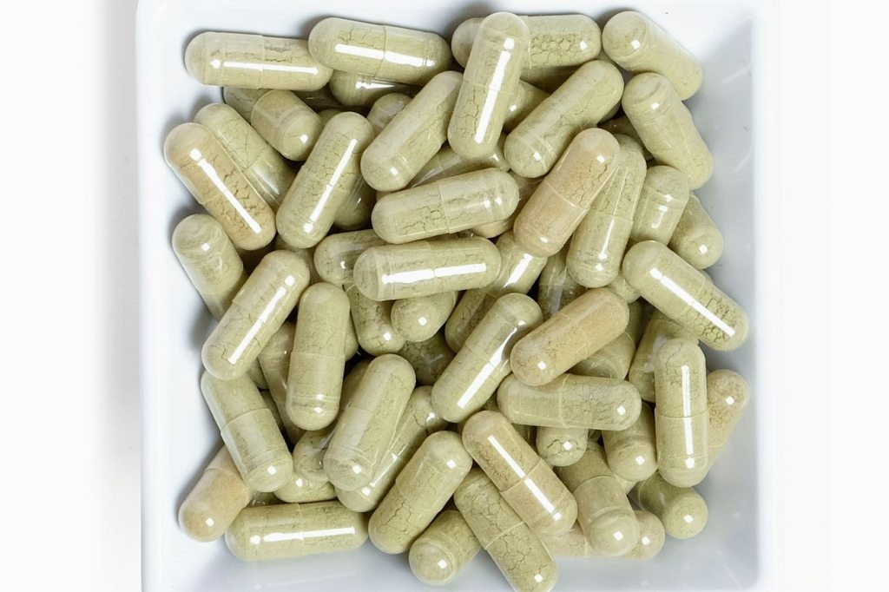
Kratom Capsules
Around 0.3gm to 1gm kratom
Variable by capsule size

Slide 58
Kratom Gummies (Using Extract)
Around 30mg (variable) mitragynine

Slide 59
Kratom Liquids and Tinctures (Using Extract)
Typically measured in mg/ml
O.5gm equals 5-6 gm Kratom

Slide 60
Kratom Side Effects and Toxicity
From 2011-2017 US poison control reported 52-fold increase in annual kratom exposures [16]
Most adverse events associated with higher doses (greater than 8 grams) and frequency of dosing.
  Risk of dependence and addiction [17,18,19]
  Cognitive Impairment [20]
  Agitation [20]
  Tachycardia [20]
  Drowsiness and confusion [20]
  Seizures [20]
  Psychosis and hallucinations [20]
  Coma

Slide 61
User Reported Side Effects
Nausea and vomiting
Headaches
Diarrhea and rectal bleeding
Constipation
Hair loss
Itching
Decreased libido
Sweating
Decreased appetite
Tremors
Dysphoria

Slide 62
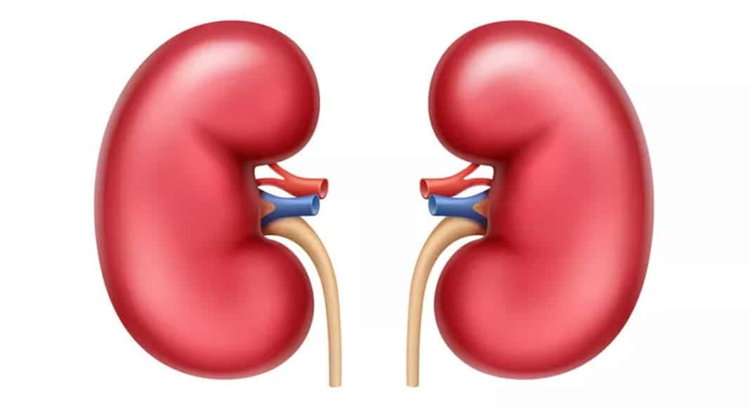
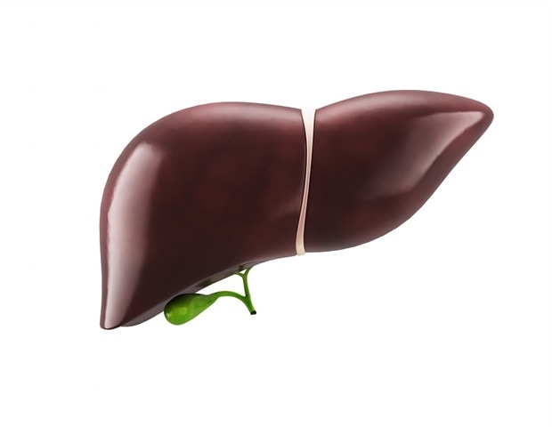
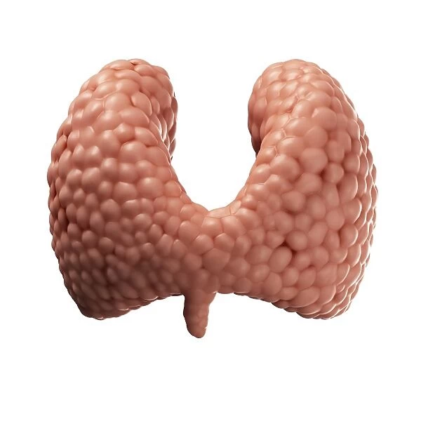
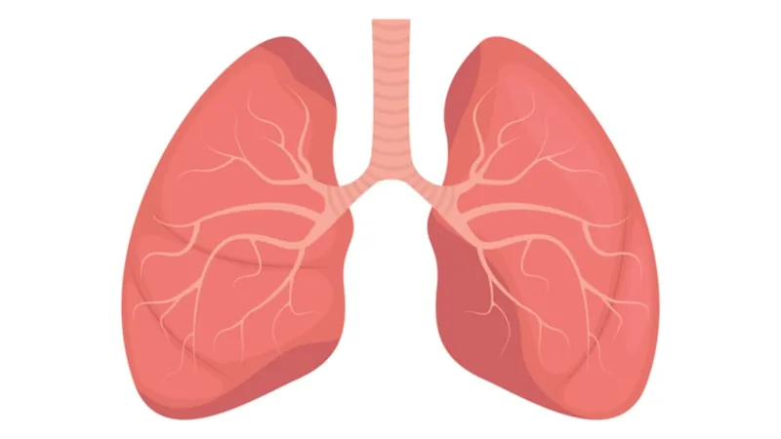
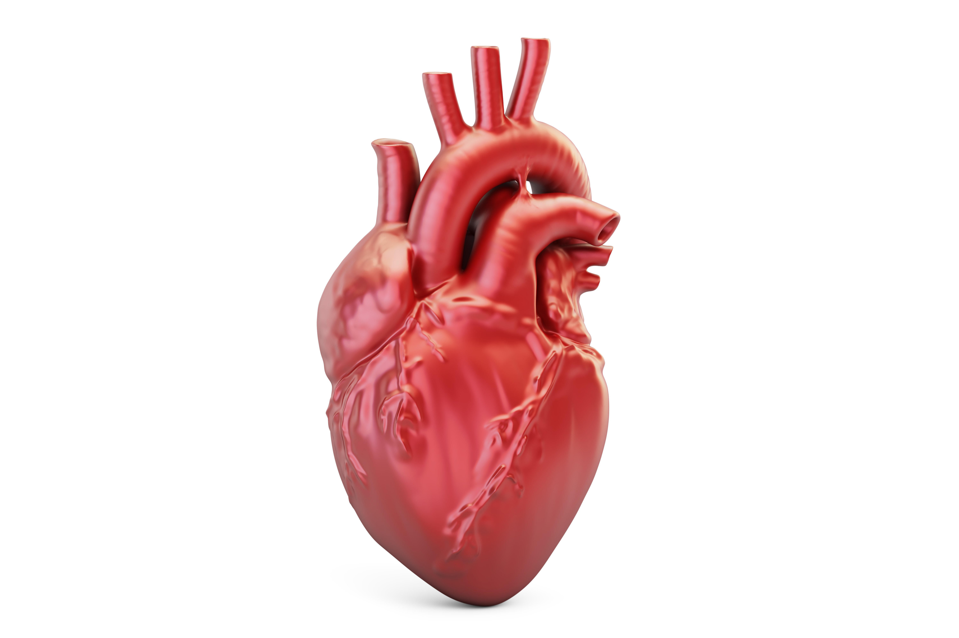
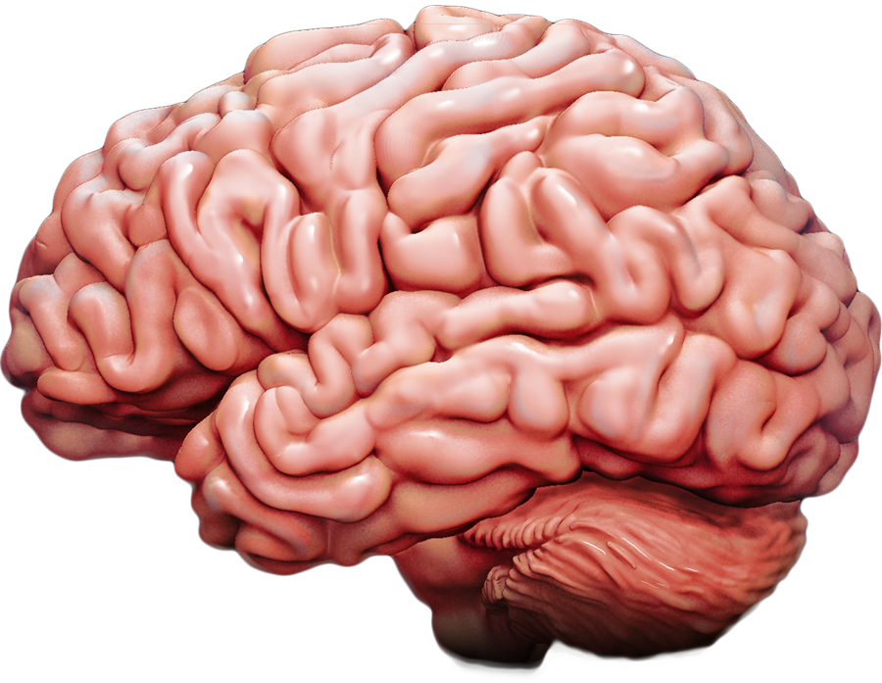

Slide 63
Kratom Induced Organ Damage
Kidney Injury [21]
Cardiotoxicity and arrhythmia [22,23]
Thyroid injury and hypothyroidism [24]
Lung injury and Acute Respiratory Distress Syndrome [25,26]
Hepatic Injury [27,28-36]
Neurological complications: acute brain injury, coma [37]
Seizures [38,39]
Death in rare cases, but incidence is rising according to CDC
  44 deaths reported up until 2017

Slide 64
Can You Overdose on Kratom?
Cluster of 7-OH related deaths have been reported in LA County
Clinical manifestation similar to other opioid toxicity
  Usually with dosing over 15gm [7]
Artificially increasing 7-OH-mitragynine
  Higher concentration enhances potency, may pose a greater risk [50]
Management of Kratom overdose
  Treatment of organ specific toxicity
  Reversal Agents (naloxone)
    No clinical trials looking at use of reversal agents.
    Case studies have supported its use and are are speculated to be beneficial [51,52]

Slide 65
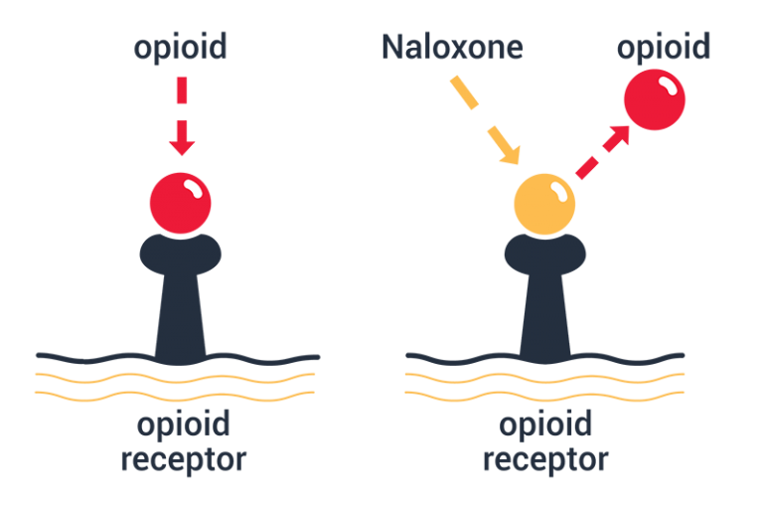

Slide 66
Kratom Metabolism and Drug Testing
Kratom is metabolized in the liver
  Mitragynine metabolized to 7-OH mitragynine
Kratom drug tests target mitragynine
Kratom POC drug tests are available
  Forensic Use only (law enforcement)
  Not CLIA waived
Confirmatory Testing
  Liquid chromatography
Half-life around 24 hours
Mitragynine present in urine up to 5-6 days

Slide 67
Is Kratom Addictive?
DSM-5 does not have specific diagnosis for Kratom addiction [40]
Kratom addiction is becoming increasingly more common
  Acts on same receptors as other opiates
Dependent of dose and duration and frequency of use
Addiction can commonly occur when used to treat opiate withdrawal
  Underlying addiction is not addressed

Slide 68
Tolerance and Dependence
Tolerance- Reduced reaction to a drug due to repeated use.
Dependence- An adaptive state making it necessary re-consume a drug in order to avoid withdrawal symptoms

Slide 69
Is Kratom Addictive?
Possibly less risk of addiction than with other opiates due to the way Kratom interacts with opioid receptors [41-44]
  Partial Agonist of the opioid receptors
Addiction potential may differ due to different concentrations of Mitragynine and 7-OH-Mitragynine
  7-OH Mitragynine appears to be the most active metabolite
  Higher affinity of 7-OH Mitragynine for the opiate receptor [45]
  Higher concentrations of 7-OH mitragynine may increase risk
  Mice seek 7-OH mitragynine but not mitragynine

Slide 70
Kratom Withdrawal Symptoms
Similar to Opiate withdrawal symptoms [46]
  Cravings
Somatic Complaints
  Nausea, vomiting, rhinorrhea, sialorrhea, body aches, restlessness, restless legs, headache, fatigue, insomnia [47]
Physical exam findings
  Mydriasis, hypothermia, tremors, diaphoresis
Psychiatric symptoms
  Anxiety, dysphoria, depression, irritability [48,49]

Slide 71
Management of Kratom Abuse and
Addiction
Stabilization and prevention of organ injury
  Hepatic, renal, neurological, etc.
Alleviation of symptoms in acute withdrawal
  Clonidine or other alpha-2-agonists and hydroxyzine [56]
  Buprenorphine-naloxone [57]
Long-term maintenance of sobriety
  Substance abuse treatment programs
  12-step programs
  Pharmacologic treatment

Slide 72
Opioid Replacement Therapy for Kratom Addiction
Opioid Use Disorder- Opioid agonist therapy with buprenorphine is effective and evidenced based treatment, and approved by FDA
  Buprenorphine has a high affinity for opioid receptors
  Acts as a partial agonist
  Produces opioid-like effects with ceiling response
  Concise clinical guidelines exist
Buprenorphine for Kratom addiction is not FDA approved
For motivated Kratom addicts, it is logical to assume that treatment would be similar as for other opioid addictions
  Prevents mitragynine and 7-OH-mitragynine from binding to receptor
  Several case reports have shown efficacy [59-66]

Slide 73
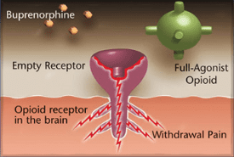

Slide 74
Buprenorphine for Kratom Withdrawal
Evidence is growing but still limited
  No large randomized clinical studies
Buprenorphine and buprenorphine-naloxone are used off label to treat withdrawal symptoms for Kratom [57-60, 67,68]
  Several case studies support its effectiveness
  Lack of specific treatment guidelines
    Not FDA approved-
US-based scientific expert forum published their opinions [60]
  Use opioids with caution and on a case-by case-basis
  Use may lead to tolerance, dependence and opioid use disorder

